Slide 1

Dr. Manju Khurana
Assistant Professor, CSED
TIET, Patiala
manju.khurana@thapar.edu

Slide 2
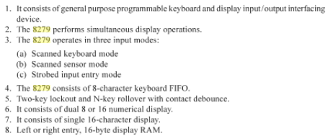

Features of 8279 PKDC

Slide 3
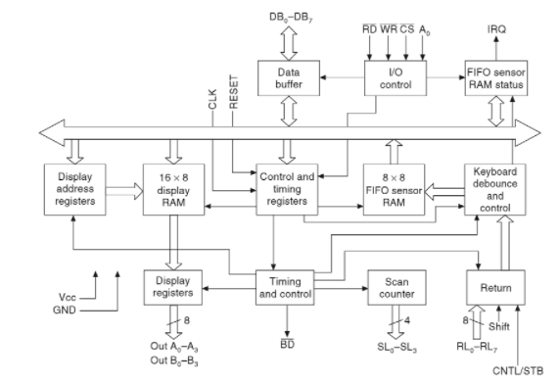
Architecture of 8279 PKDC

Slide 4


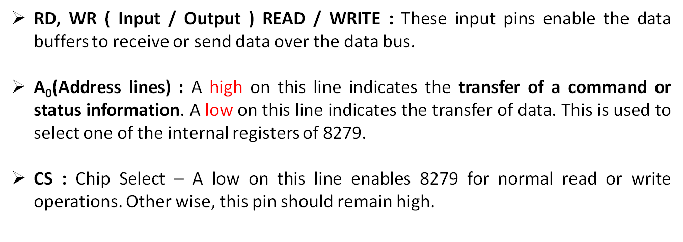
Data Buffer
I/O Control
DB₀-DB₇ : These are bidirectional data bus lines. The data and command words to and from the CPU are transferred on these lines.

Slide 5

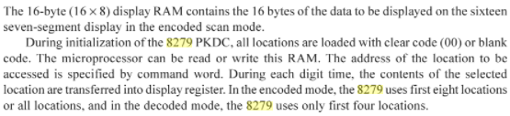

Display Address Registers
16 × 8 Display RAM
Control and Timing Registers

Slide 6



Keyboard Debounce and Control
Display Registers
Timing and Control

Slide 7

Scan Counter
Return lines

Slide 8
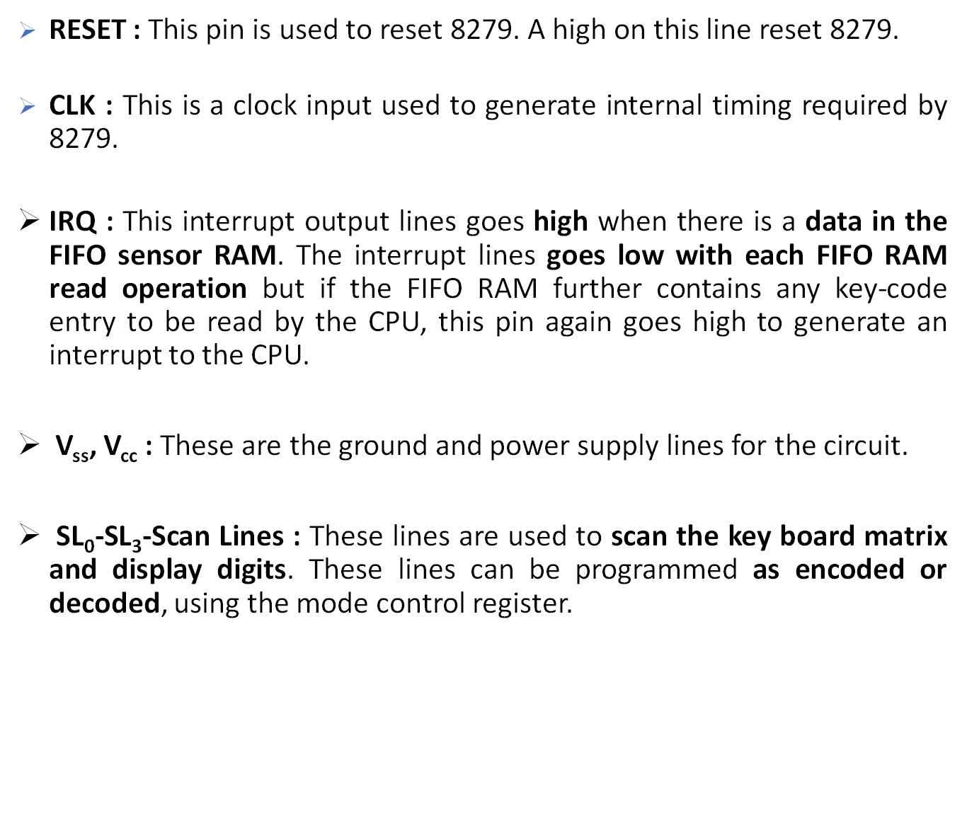

Slide 9
RL₀ - RL₇ - Return Lines : These are the input lines which are connected to one terminal of keys, while the other terminal of the keys are connected to the decoded scan lines. These are normally high, but pulled low when a key is pressed.
SHIFT : The status of the shift input lines is stored along with each key code in FIFO, in scanned keyboard mode. It is pulled up internally to keep it high, till it is pulled low with a key closure.
  CNTL/STB- CONTROL/STROBED I/P Mode : In keyboard mode, this lines is used as a control input and stored in FIFO on a key closure. The line is a strobed lines that enters the data into FIFO RAM, in strobed input mode. It has an interrupt pull up. The lines is pulled down with a key closer.
OUT A₀ – OUT A₃ and OUT B₀ – OUT B₃ : These are the output ports for two 16*4 or 16*8 internal display refresh registers. The data from these lines is synchronized with the scan lines to scan the display and keyboard. The two 4-bit ports may also as one 8-bit port.
BD – Blank Display : This output pin is used to blank the display during digit switching or by a blanking closure.

Slide 10


